Slide 1
Describing Data with Graphs

Slide 2
Learning Objectives
Data Distributions and Shapes
Dotplots
Pie charts, bar charts, line charts
Qualitative and Quantitative variables – discrete and continues
Relative frequency histograms
Stem and leaf plots
Univariate and Bivariate data
Variables, experimental units, samples and populations, data

Slide 3
Variable and Experimental Unit in Statistics
Variable: A variable in statistics refers to any characteristic, number, or quantity that can be measured or counted. It can vary among subjects or over time. Variables can be classified as quantitative (e.g., height, weight) or qualitative (e.g., gender, color).
Experimental Unit: The experimental unit is the entity or subject from which data is collected. It can be a person, a company, a plant, or even a specific object. Each experimental unit has values for the variables of interest.

Slide 4
Example
Imagine you're conducting a study to examine the relationship between age and exam scores in a group of students.
Experimental Unit: In this case, each student is an experimental unit because data (age, exam scores, and gender) is collected from them.
Variable | Definition | Example
Gender | A qualitative variable representing a categorical trait | Male, Female

Slide 5
Analogy
Think of variables as attributes or features of a car, and the experimental unit as each individual car. You might measure the speed, color, and mileage (variables), but each car (experimental unit) provides these values.

Slide 6
Types of Analysis Based on the Number of Variables
Univariate Analysis: Involves a single variable. Its primary purpose is to describe the data and find patterns.

Slide 7
Example: Studying the distribution of students' exam scores.
Student | Exam Score
A | 80
B | 85
C | 70
Focus: Measures like mean, median, mode, and standard deviation.

Slide 8
Bivariate Analysis
Involves two variables to determine relationships between them. Often used in correlation or regression analysis.

Slide 9
Example: Studying the relationship between age and exam scores.
Student | Age | Exam Score
A | 20 | 80
B | 22 | 85
C | 19 | 70
Focus: Techniques like multivariate regression, factor analysis, and PCA (Principal Component Analysis).

Slide 10
Analogy
Univariate: Imagine looking at the color of different cars. You are only concerned with one characteristic.
Bivariate: You now look at both the color and speed of cars to see if certain colored cars tend to be faster.
Multivariate: Now, you analyze the color, speed, mileage, and engine type of cars to find patterns and relationships among all variables.

Slide 11
Summary of Types of Analysis
Type of Analysis | Number of Variables | Purpose | Example
Univariate | 1 | Describes the distribution or central tendency | Examining exam scores only.
Bivariate | 2 | Analyzes the relationship between two variables | Studying how age affects exam scores.
Multivariate | 3+ | Analyzes relationships among multiple variables | Studying how age, gender, and exam preparation affect scores.
This structured view makes it easier to differentiate between the three types of analyses based on how many variables you are dealing with.

Slide 12
Types of Variables: Qualitative and Quantitative
In statistics, variables can be classified into two major types:
Qualitative (Categorical) Variables
Quantitative (Numerical) Variables

Slide 13
1. Qualitative (Categorical) Variables
Definition: Qualitative variables represent categories or qualities. These variables are non-numerical and describe characteristics, attributes, or categories that cannot be measured directly.
Types of Qualitative Variables:
Nominal: Categories that do not have any inherent order.
Example: Gender, Eye Color
Ordinal: Categories that have a natural order, but the difference between them is not measurable.
Example: Education Level (High School, Bachelor's, Master's, PhD)

Slide 14
Example Table
Person | Eye Color (Nominal) | Education Level (Ordinal)
A | Brown | Bachelor's
B | Blue | Master's
C | Green | PhD

Slide 15
Analogy
Think of qualitative variables like the types of fruits at a grocery store. You have apples, bananas, and oranges (categories).
These fruits can’t be measured by numbers but simply fall into different categories.
You can say apples are red (nominal), and large-sized fruits are better (ordinal).

Slide 16
2. Quantitative (Numerical) Variables
Definition: Quantitative variables represent measurable quantities and are expressed numerically. These variables can be counted or measured and can take on a wide range of numerical values.
Types of Quantitative Variables:
Discrete: Values that can be counted, typically integers.
Example: Number of Children, Number of Cars Owned
Continuous: Values that can take any real number within a given range and are often measured.
Example: Height, Weight, Temperature

Slide 17
Example Table
Person | Number of Cars (Discrete) | Height (Continuous)
A | 2 | 5.7 feet
B | 1 | 6.2 feet
C | 3 | 5.9 feet

Slide 18
Analogy
Imagine quantitative variables like containers filled with liquid. If you have cups filled with water, you can measure the exact amount (e.g., 200 mL, 350 mL).
In the case of discrete variables, it’s like counting the number of containers (1 cup, 2 cups, etc.).

Slide 19
Key Differences Between Qualitative and Quantitative Variables
Type of Variable | Definition | Examples
Qualitative | Describes categories or characteristics, not numerical | Eye color, Education level, Nationality
Quantitative | Represents numerical values that can be counted or measured | Age, Weight, Number of cars

Slide 20
Detailed Comparison of Qualitative and Quantitative Variables
Aspect | Qualitative Variable | Quantitative Variable
Data Type | Non-numerical categories | Numerical values
Subtypes | Nominal, Ordinal | Discrete, Continuous
Measurement | Based on labels or descriptions | Based on quantities or amounts
Examples | Gender (Male, Female), Eye Color (Blue, Brown) | Age (25 years), Weight (60 kg), Number of cars (3)
Application | Used for grouping or categorization | Used for mathematical calculations and measurements
Representation | Bar charts, Pie charts | Histograms, Line charts

Slide 21
Summary
Type | Subtypes | Description | Examples
Qualitative | Nominal, Ordinal | Describes categories or qualities (non-numerical) | Gender, Nationality, Eye Color
Quantitative | Discrete, Continuous | Describes numerical values (can be counted or measured) | Age, Height, Number of Cars, Temperature

Slide 22
Discrete vs. Continuous Variables
Quantitative variables, as discussed earlier, can be further classified into two types:
Discrete Variables
Continuous Variables

Slide 23
1. Discrete Variables
Definition: Discrete variables represent countable quantities. These values take on specific, distinct numbers (usually integers), and there are no intermediate values between them.

Slide 24
Example Table (Discrete Variables):
Person | Number of Cars (Discrete)
A | 2
B | 1
C | 3
Number of Cars: This variable is discrete because you can only have a whole number of cars (e.g., 1 car, 2 cars, but not 1.5 cars).

Slide 25
2. Continuous Variables
Definition: Continuous variables represent quantities that can take any value within a range. They can include decimals or fractions, and their values are measured rather than counted.

Slide 26
Example Table (Continuous Variables):
Person | Height (Continuous)
A | 5.7 feet
B | 6.2 feet
C | 5.9 feet
Height: This variable is continuous because it can take on any value, including decimals (e.g., 5.7 feet, 6.2 feet). Height can be measured to many decimal places, depending on the precision of the measuring tool.

Slide 27
Key Differences Between Discrete and Continuous Variables
Aspect | Discrete Variables | Continuous Variables
Definition | Countable quantities with distinct values | Measurable quantities that can take any value
Range of Values | Whole numbers, no fractions/decimals allowed | Can include fractions, decimals, and real numbers
Examples | Number of cars, Number of children | Height, Weight, Temperature
Measurement Type | Counting | Measuring
Visualization | Bar chart | Histogram, Line chart

Slide 28
Activity 1
In a survey concerning public education, 400 school administrators were asked to rate the quality of education in the United States. Their responses are rated: A and Frequency 35, B - 260, C - 93, D - 12. Construct a table that shows the ratings along with the frequencies, relative frequencies, percentages, and sector angles to construct the pie chart.

Slide 29
Frequencies: The given data represents the number of school administrators who rated the quality of education as A, B, C, or D.
Relative Frequency: This is calculated by dividing each frequency by the total number of responses (400 in this case).
Relative Frequency=Frequency/Total Responses
Percentage: Multiply the relative frequency by 100 to get the percentage.
Percentage=Relative Frequency×100
Sector Angle: To find the angle for each rating in a pie chart, multiply the relative frequency by 360 degrees (since the total circle in a pie chart is 360 degrees).
Sector Angle=Relative Frequency×360Sector Angle=Relative Frequency×360

Slide 30
Given Data
Total Responses: 400
Frequencies:
A: 35
B: 260
C: 93
D: 12

Slide 31
Step-by-Step Calculation
Rating | Frequency (f) | Relative Frequency (f/400) | Percentage (f/400 × 100) | Sector Angle (f/400 × 360)
A | 35 | 35/400 = 0.0875 | 0.0875 × 100 = 8.75% | 0.0875 × 360 = 31.5°
B | 260 | 260/400 = 0.65 | 0.65 × 100 = 65% | 0.65 × 360 = 234°
C | 93 | 93/400 = 0.2325 | 0.2325 × 100 = 23.25% | 0.2325 × 360 = 83.7°
D | 12 | 12/400 = 0.03 | 0.03 × 100 = 3% | 0.03 × 360 = 10.8°

Slide 32
Final Table
Rating | Frequency (f) | Relative Frequency | Percentage | Sector Angle (degrees)
A | 35 | 0.0875 | 8.75% | 31.5°
B | 260 | 0.65 | 65% | 234°
C | 93 | 0.2325 | 23.25% | 83.7°
D | 12 | 0.03 | 3% | 10.8°

Slide 33
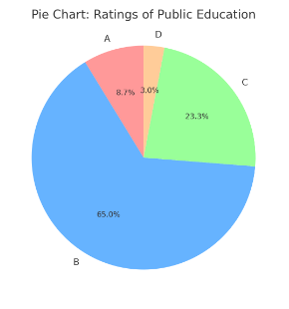

Slide 34
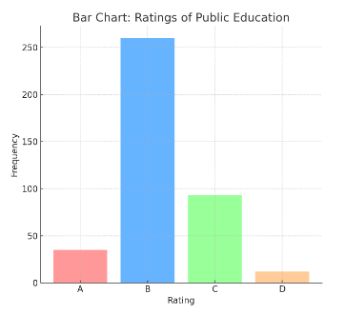

Slide 35
1. Pie Chart
Benefits:
Visual Proportions: Pie charts are excellent for showing how a whole is divided into parts. Each "slice" represents a proportion of the total (in this case, ratings of public education), making it easy to see which categories dominate.
Comparing Parts to the Whole: Pie charts quickly communicate the relative size of each part in comparison to the entire dataset. For example, you can instantly see that "B" has the largest slice, meaning most people rated public education as "B".
Ideal for Percentages: Pie charts are often used when data is presented in percentages, as they help people visualize parts of 100%.

Slide 36
Why Use a Pie Chart?
When the goal is to emphasize proportions or percentages out of a total.
When there are only a few categories to compare (typically 3-6) because too many slices make the chart cluttered and hard to interpret.
In This Case:
The pie chart clearly shows that "B" (65%) is the dominant response, followed by "C" (23.25%) and much smaller portions for "A" (8.75%) and "D" (3%). The visual impact of the large and small slices helps highlight which ratings are most and least common.

Slide 37
2. Bar Chart
Benefits:
Clear Comparison: Bar charts are ideal for comparing the exact quantities (frequencies) of categories. The height of each bar directly represents the value, making it easy to see how different categories compare.
Exact Numbers: Unlike a pie chart that focuses on proportions, bar charts show exact frequencies or counts, which is helpful when you want to see the actual values.
Handles Many Categories Well: Bar charts work well even with a larger number of categories, whereas pie charts get cluttered if there are too many slices.
.

Slide 38
Why Use a Bar Chart?
When the goal is to compare specific quantities (like frequencies) between different categories.
When you want to easily compare individual values side by side (e.g., how many administrators gave a "B" rating compared to those who gave a "C" rating).
When there are multiple categories, and you need clarity on the differences between them.
In This Case:
The bar chart shows the exact number of administrators who rated public education as "A" (35), "B" (260), "C" (93), and "D" (12). The heights of the bars provide a clear visual comparison, making it easy to see that "B" had the highest number of responses

Slide 39
When to Use Each Chart
Use a Pie Chart if you want to emphasize relative proportions or percentages of a total.
Use a Bar Chart if you want to emphasize exact values and make direct comparisons between categories.

Slide 40
Graphs for Categorical Data

Slide 41
Activity 2
A snack size bag contains 21 candies with colors, 6 brown, 3 green, 3 orange, 2 yellow, 2 red and 5 blue. Construct a table with category, tally, frequency, relative frequency and percentage columns.

Slide 42
Step-by-Step Breakdown
Frequency: The number of candies of each color is already provided.
Relative Frequency: This is calculated by dividing the frequency by the total number of candies (21).
Relative Frequency=Frequency/Total Candies=Frequency/21
Percentage: Multiply the relative frequency by 100 to get the percentage.
Percentage=Relative Frequency×100

Slide 43
Given Data
Total Candies: 21
Colors and Frequencies:
Brown: 6
Green: 3
Orange: 3
Yellow: 2
Red: 2
Blue: 5

Slide 44
Explanation
Frequency (f): This is the count of each color (as provided).
Relative Frequency: This is the frequency of each color divided by the total (21 candies).
Percentage: The relative frequency multiplied by 100 to show the percentage.

Slide 45
Out put table
Category (Color) | Frequency (f) | Relative Frequency | Percentage (%)
Brown | 6 | 0.2857 | 28.57%
Green | 3 | 0.1429 | 14.29%
Orange | 3 | 0.1429 | 14.29%
Yellow | 2 | 0.0952 | 9.52%
Red | 2 | 0.0952 | 9.52%
Blue | 5 | 0.2381 | 23.81%

Slide 46
Graphs for Quantitative Data

Slide 47
Activity 3
The amount of money expended by the U.S department of Defense in various categories is shown in the table. Construct both a Pie chart and Bar chart to describe the data. Compare the two forms of presentation.

Slide 48
Table
Category | Amount
Military Peronnel | 147.3
Operation and maintenance | 259.3
Procurement | 129.2
R and D | 79
Construction | 17.6
Other | 4.3
Total | 636.7

Slide 49
Pie Chart

Slide 51
Line Chart
A line chart is a type of graph used to display information that changes over time. It consists of a series of data points connected by straight line segments. The horizontal axis (x-axis) typically represents time or categories, while the vertical axis (y-axis) represents the values of the variable being measured.

Slide 52
Key Features of a Line Chart
Data Points: These represent individual measurements or values.
Lines: The lines connecting the points help to visualize trends over time or across categories.
Axes: The x-axis typically represents time or categories, and the y-axis represents the value of the data.

Slide 53
Why Use a Line Chart?
To show trends over time.
To compare changes between multiple datasets (e.g., multiple lines on the same chart).
To easily observe increases, decreases, or patterns in data.

Slide 54
Example 1: Monthly Temperature of a City
Imagine you're tracking the average temperature in your city over a year. A line chart can help you visualize how the temperature fluctuates each month.

Slide 55
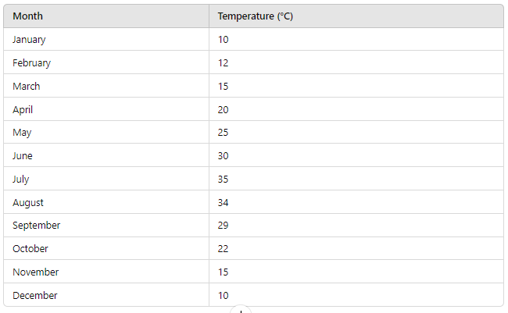
A line chart for this data would show the temperature rising from January to July and then falling again towards December, forming a mountain-like shape over the year.

Slide 56
Analogy
Think of a line chart as a mountain path when you're hiking. As you walk uphill (temperature or value increases), you can see how steep the climb is, then as you go downhill, you notice the slope decreasing. This is similar to how a line chart helps visualize upward and downward trends in data over time.

Slide 57
When to Use a Line Chart
When you need to show continuous data over time (e.g., stock prices, temperatures, sales).
When you're interested in trends or patterns.
When you want to compare multiple datasets that change over time.

Slide 58
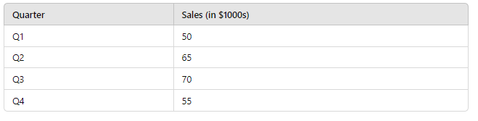
Example 2: Company’s Quarterly Sales
Let’s say a company tracks its quarterly sales for a year.
A line chart would illustrate how sales grow from Q1 to Q3 and then decline slightly in Q4.

Slide 59
Example 2

Slide 60
Dot Plot
A dot plot is a simple statistical chart that displays the frequency or distribution of data points for a specific dataset.
Each data point is represented as a dot on the graph, and dots are often stacked vertically to show the number of occurrences of each value.
Dot plots are useful for visualizing small to moderate-sized datasets and spotting clusters, gaps, and outliers.

Slide 61
Key Features
Data points: Each dot represents a single data point or observation.
Horizontal axis: The values or categories being analyzed (e.g., test scores, number of candies).
Vertical stacking: When multiple data points share the same value, the dots are stacked vertically to show frequency.

Slide 62
Example 1: Test Scores
Imagine a teacher wants to display the distribution of test scores for a class of 20 students, with scores ranging from 50 to 100. The scores might be:

Slide 63
Stem and Leaf Display
A leaf and stem plot, also called a stem-and-leaf plot, is a way to organize numerical data to display its distribution.
It helps visualize the shape of the data, shows individual values, and gives an idea of the spread and center of the dataset.

Slide 64
How it Works
Imagine the stem-and-leaf plot as a simple tree:
The stem represents the tens place (or higher place values).
The leaf represents the ones place (or the last digit).
In this way, each data point is broken into two parts:
The stem shows the leading digits.
The leaf shows the trailing digit.

Slide 65
Analogy
Think of it as sorting books on a shelf:
Stem: Think of this as the main categories (like genres or subject areas) where books belong.
Leaf: Each book in that category has a specific title (which would be the final digit). So, you might have multiple books under the same genre/category, but their titles (final digits) are different.

Slide 66
Example
Let’s say you have the following data representing the ages of students in a class:
22, 25, 26, 29, 31, 33, 35, 38, 42, 47
Here’s how you would represent it in a stem-and-leaf plot:
Stem | Leaf
2 | 2 5 6 9
3 | 1 3 5 8
4 | 2 7

Slide 67
Benefits
Easy to see the distribution of data.
Shows individual data points.
Good for small to moderately sized datasets.

Slide 68
Histogram
A histogram is a type of bar graph that visually represents the distribution of numerical data.
Unlike a regular bar graph, which usually compares categories, a histogram shows how data is distributed across continuous intervals or ranges.
It helps you see the frequency of data points within certain ranges, giving you a sense of the data’s shape, spread, and central tendency.

Slide 69
How a Histogram Works
Bins (or Intervals): These are the ranges into which the data is divided. Each bin represents a specific range of values.
Bars: Each bar shows the number of data points (or frequency) that fall within each bin. The height of the bar indicates how many values are in that range.

Slide 70
Example
Let’s say you have test scores of students in a class:
Test Scores: 55, 60, 65, 65, 70, 70, 75, 75, 75, 80, 85, 85, 90, 95, 100
To create a histogram, you can group the scores into bins (ranges) of 10 points each: 50-59, 60-69, 70-79, 80-89, 90-100.
Bins (Scores) | Frequency (Number of Students)
50-59 | 1
60-69 | 3
70-79 | 5
80-89 | 3
90-100 | 3

Slide 71
Now, if you make a histogram from this data, you’ll have:
One bar for the range 50-59 (height = 1)
One bar for the range 60-69 (height = 3)
One bar for the range 70-79 (height = 5)
One bar for the range 80-89 (height = 3)
One bar for the range 90-100 (height = 3)

Slide 72
Breaking It Down
Bins: These are the score ranges (50-59, 60-69, etc.).
Bars: The height of each bar represents how many students scored within each range. For example, 5 students scored between 70 and 79, so the bar for that range is the tallest.

Slide 73
Histogram vs. Bar Graph
A bar graph compares different categories (e.g., types of fruit).
A histogram deals with continuous numerical data, grouped into ranges (e.g., test scores, ages, etc.).

Slide 74
Difference between a bar graph and a histogram
The fundamental difference between histograms and bar graphs from a visual aspect is that the bars in a bar graph are not adjacent to each other.
A bar graph is the graphical representation of categorical data using rectangular bars where the length of each bar is proportional to the value they represent.
A histogram is the graphical representation of data where data is grouped into continuous number ranges and each range corresponds to a vertical bar.

Slide 75
Difference between a bar graph and a histogram
Bar Graph | Histogram
Bar graph represents categorical data. | Histogram represents numerical data (discrete or continuous data).
Equal space between every two consecutive bars. | No space between two consecutive bars. They should be attached to each other.
Data can be arranged in any order. | Data is arranged in the order of range.
The x-axis can represent anything. | The x-axis should represent only continuous data that is in terms of numbers.
However, in both the graphs, the y-axis represents numbers only

Slide 76
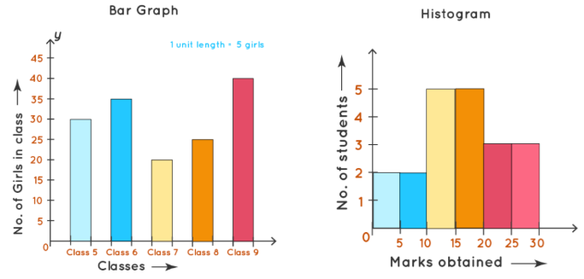
Difference between a bar graph and a histogram

Slide 77
Real-Life Analogy
Imagine you're tracking the height of trees in a forest. Instead of measuring each tree individually, you group them into height ranges (bins):
Trees 0-5 feet tall, 6-10 feet tall, 11-15 feet tall, etc.
You then count how many trees fall into each height range and create bars for each range.
If most trees are between 6-10 feet tall, the bar for that range will be the tallest. If very few trees are over 15 feet tall, that bar will be much shorter. The histogram helps you quickly see how tree heights are distributed across the forest.

Slide 78
Benefits of Histograms
Visualize distribution: You can quickly see how data is spread across different ranges.
Spot patterns or outliers: If the data is skewed or has extreme values, a histogram makes it obvious.
Identify central tendencies and spread: It gives a clear picture of where most data points fall and how wide the distribution is.

